Slide 1
Company insights
Part 1: web scraping
Date – 04/30/2023

Slide 2
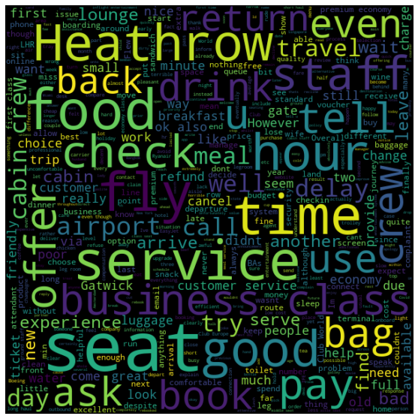
Key Points and Metrics from customers reviews
Most used words in review

Slide 3
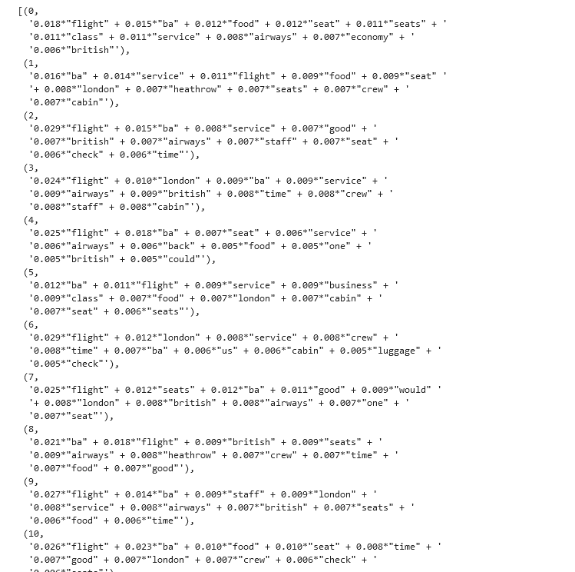
Snippet of the top 10 topics from the model

Slide 4
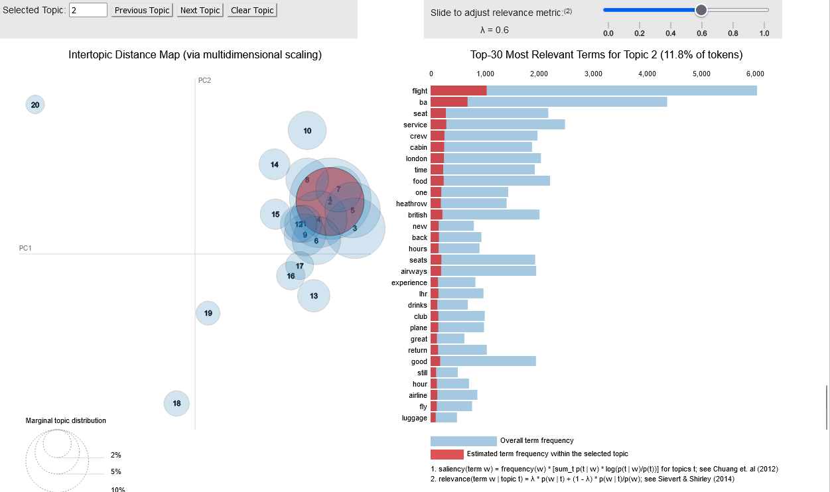
Visualization on the topics

